Slide 1
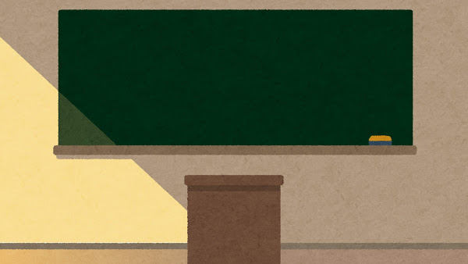
Classroom English!

Slide 2
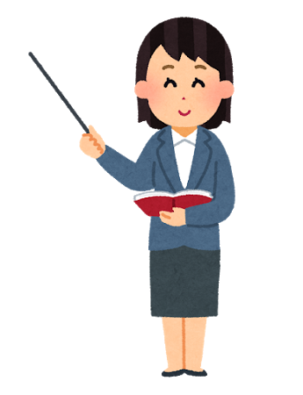
Good Morning!
Good Afternoon!

Slide 3

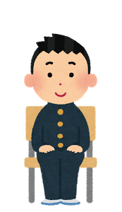
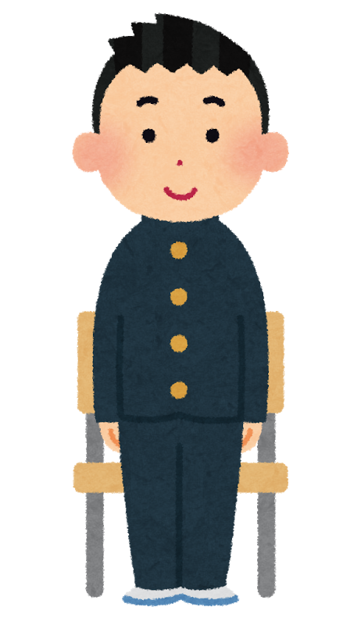
Please stand up.
Please sit down.

Slide 4
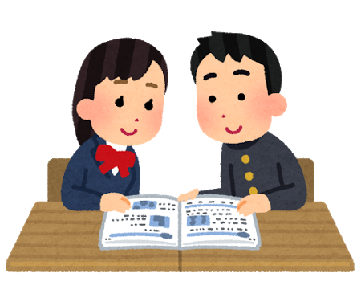
Work in pairs.

Slide 5
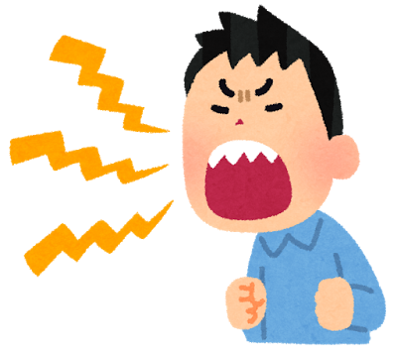
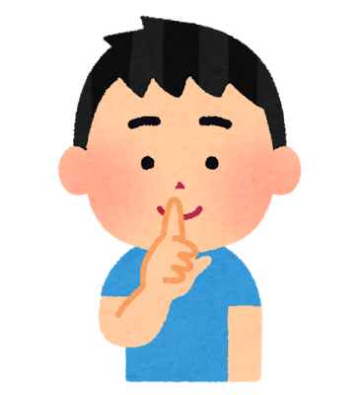
Please be quiet.

Slide 6
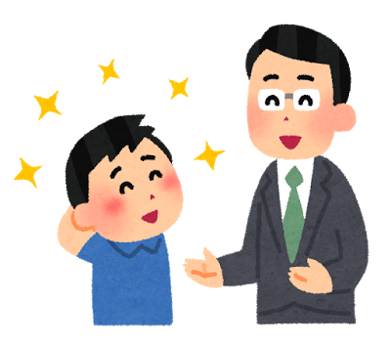
Good job! Well done!

Slide 7
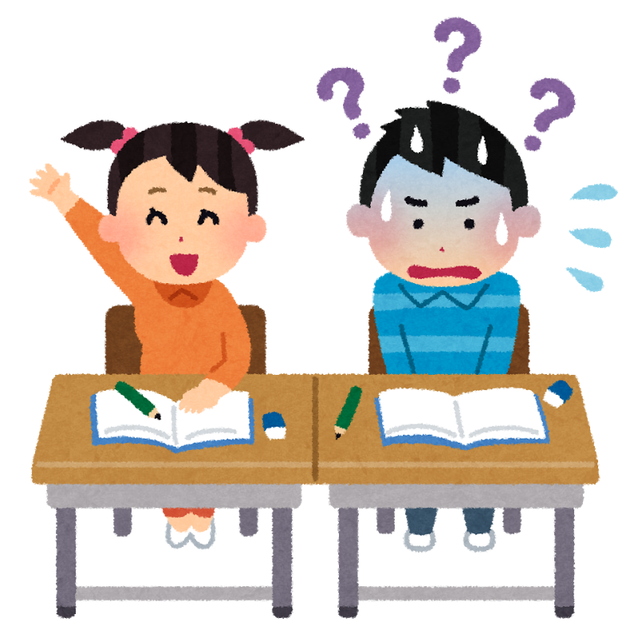
Do you understand?
Yes!
No!

Slide 8
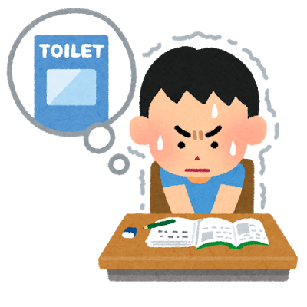
In English, please.
トイレいってもいいですか
Can I go to the toilet please?

Slide 9

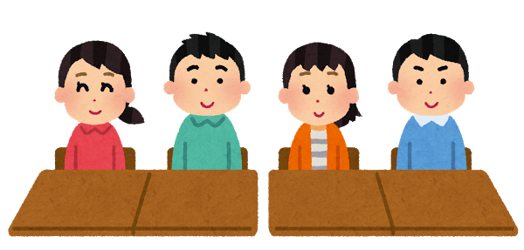
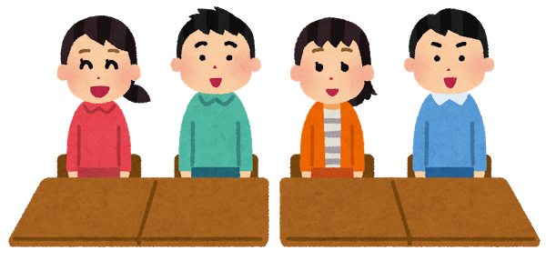
Listen,
and repeat.
Good morning!
Good morning!

Slide 10
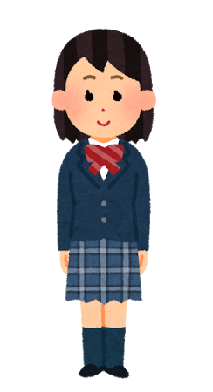
Please come to the front.
Please go to your desk.

Slide 11
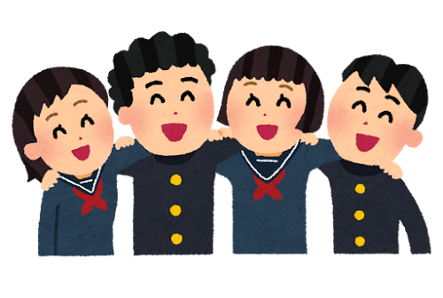
Make a group of 4.

Slide 12
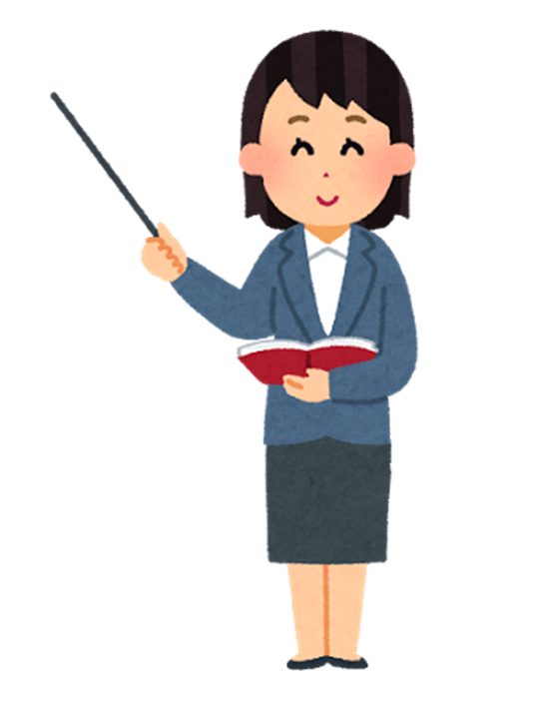


Raise your hand!

Slide 13

See you next time!

