Slide 1
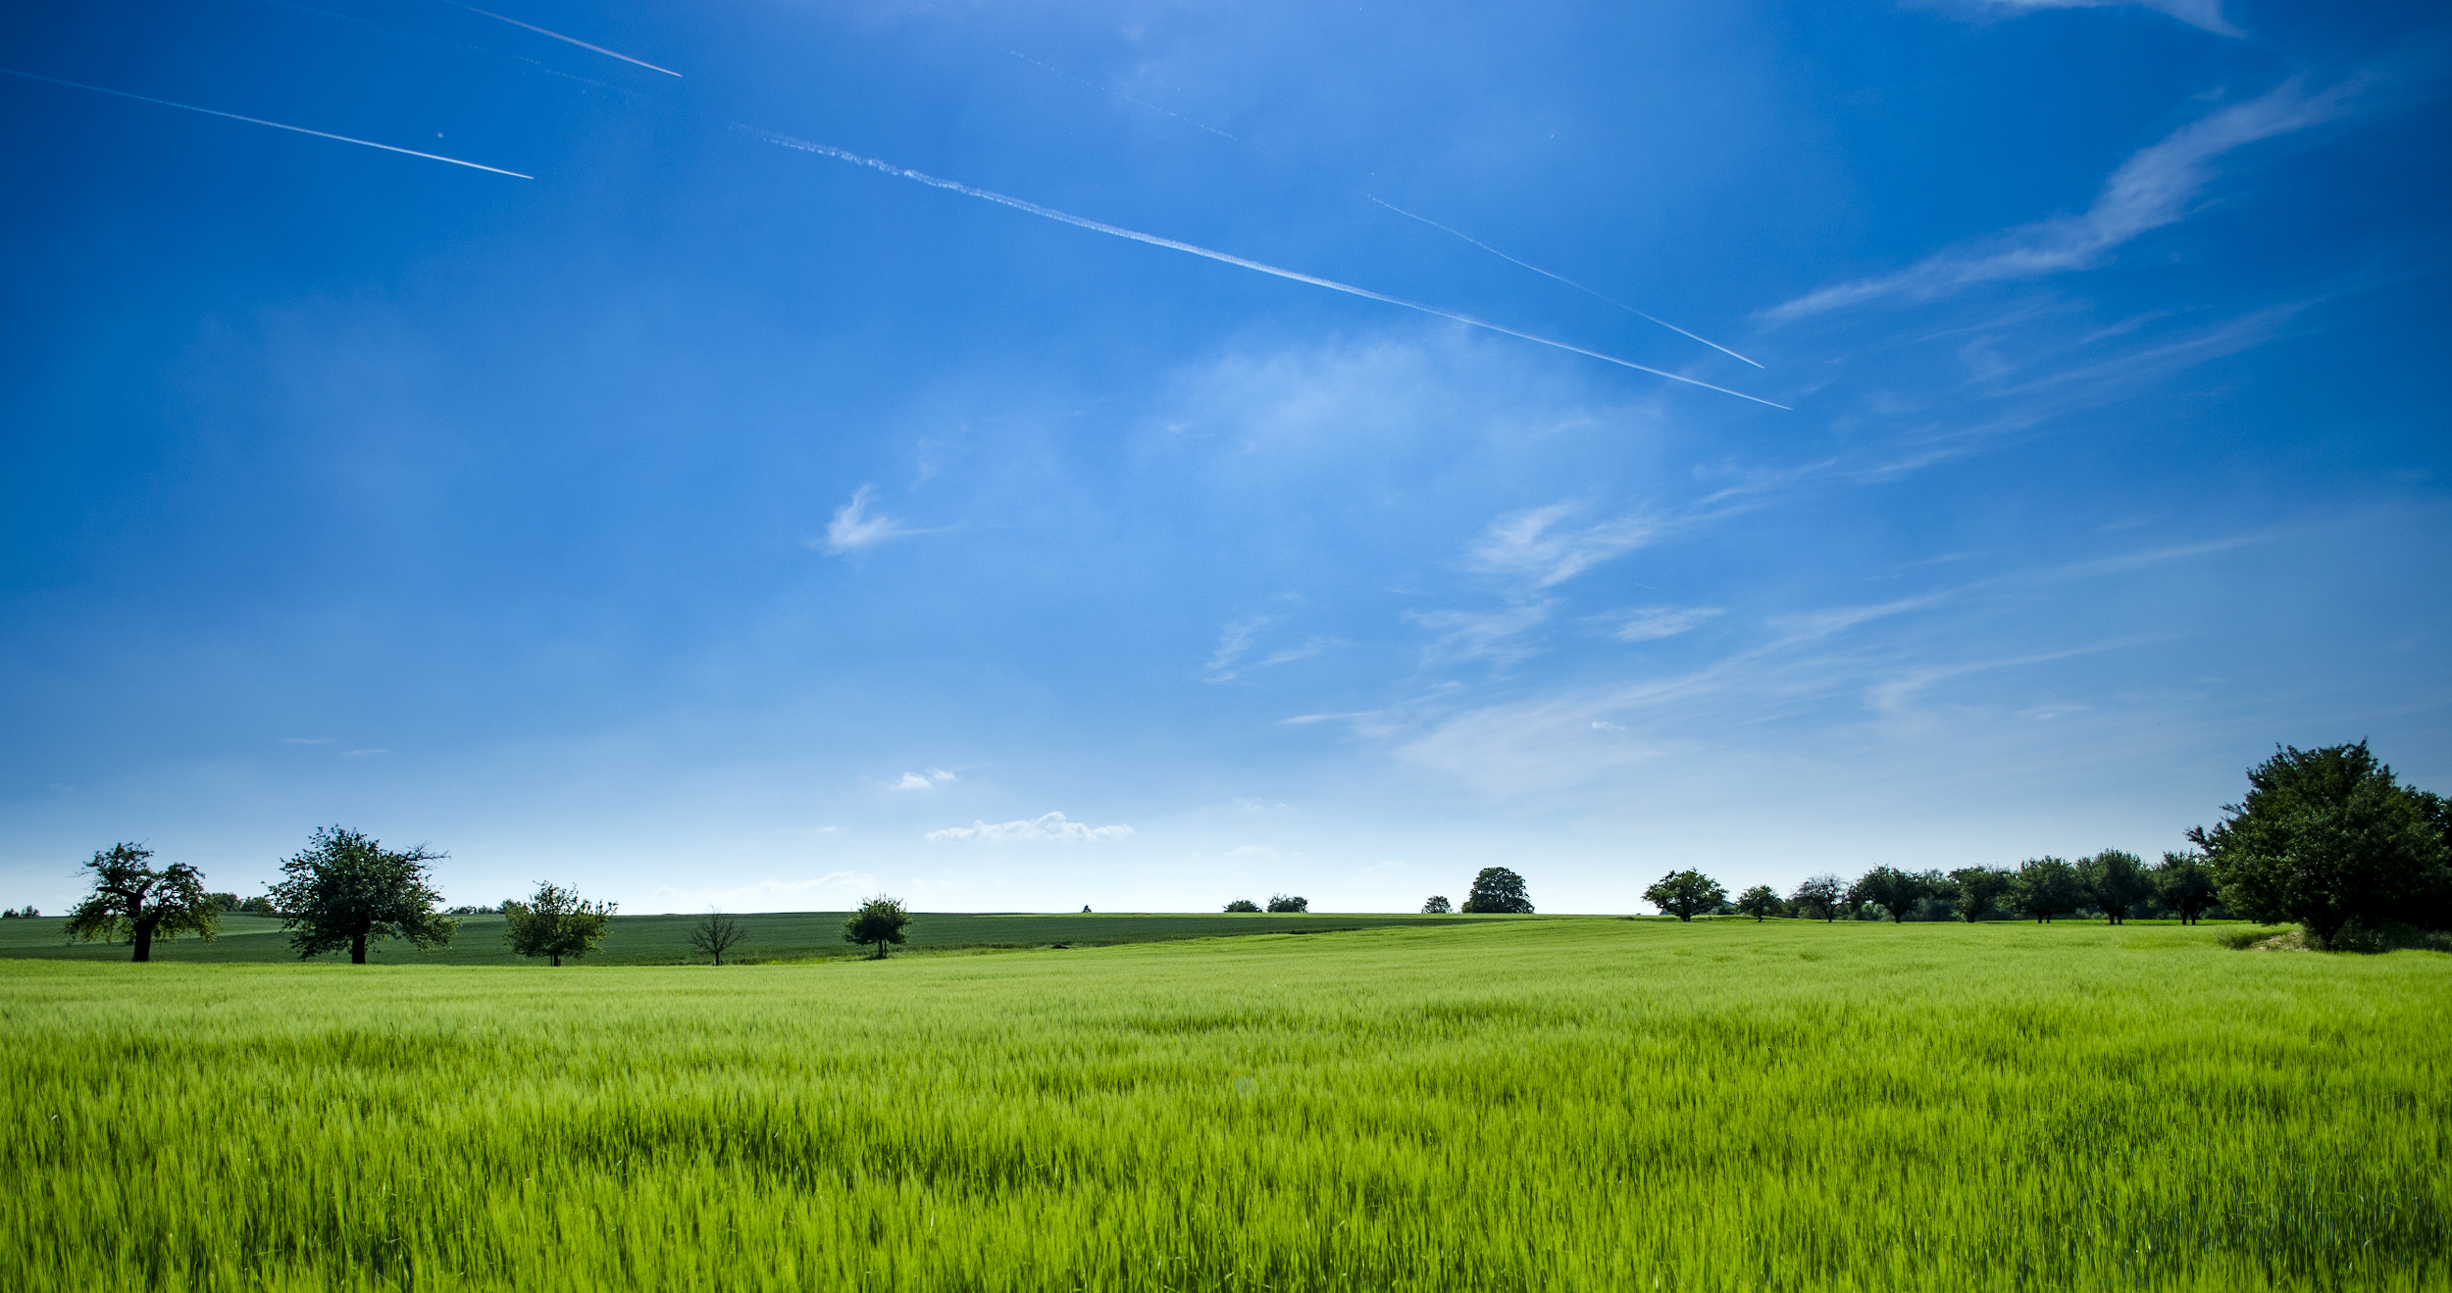
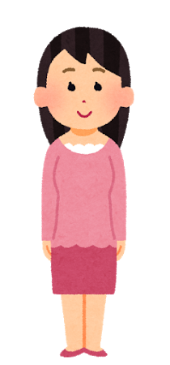
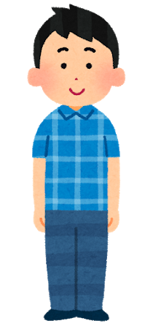
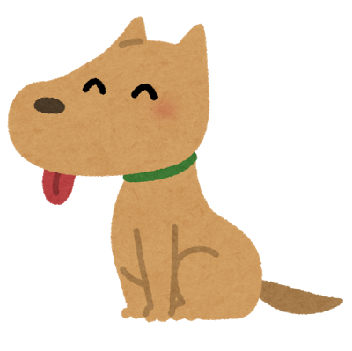
The Seasons
With Dog and Friends!
Hello, my name is Haruto!
Hello, my name is Yui!
WOOF!

Slide 2
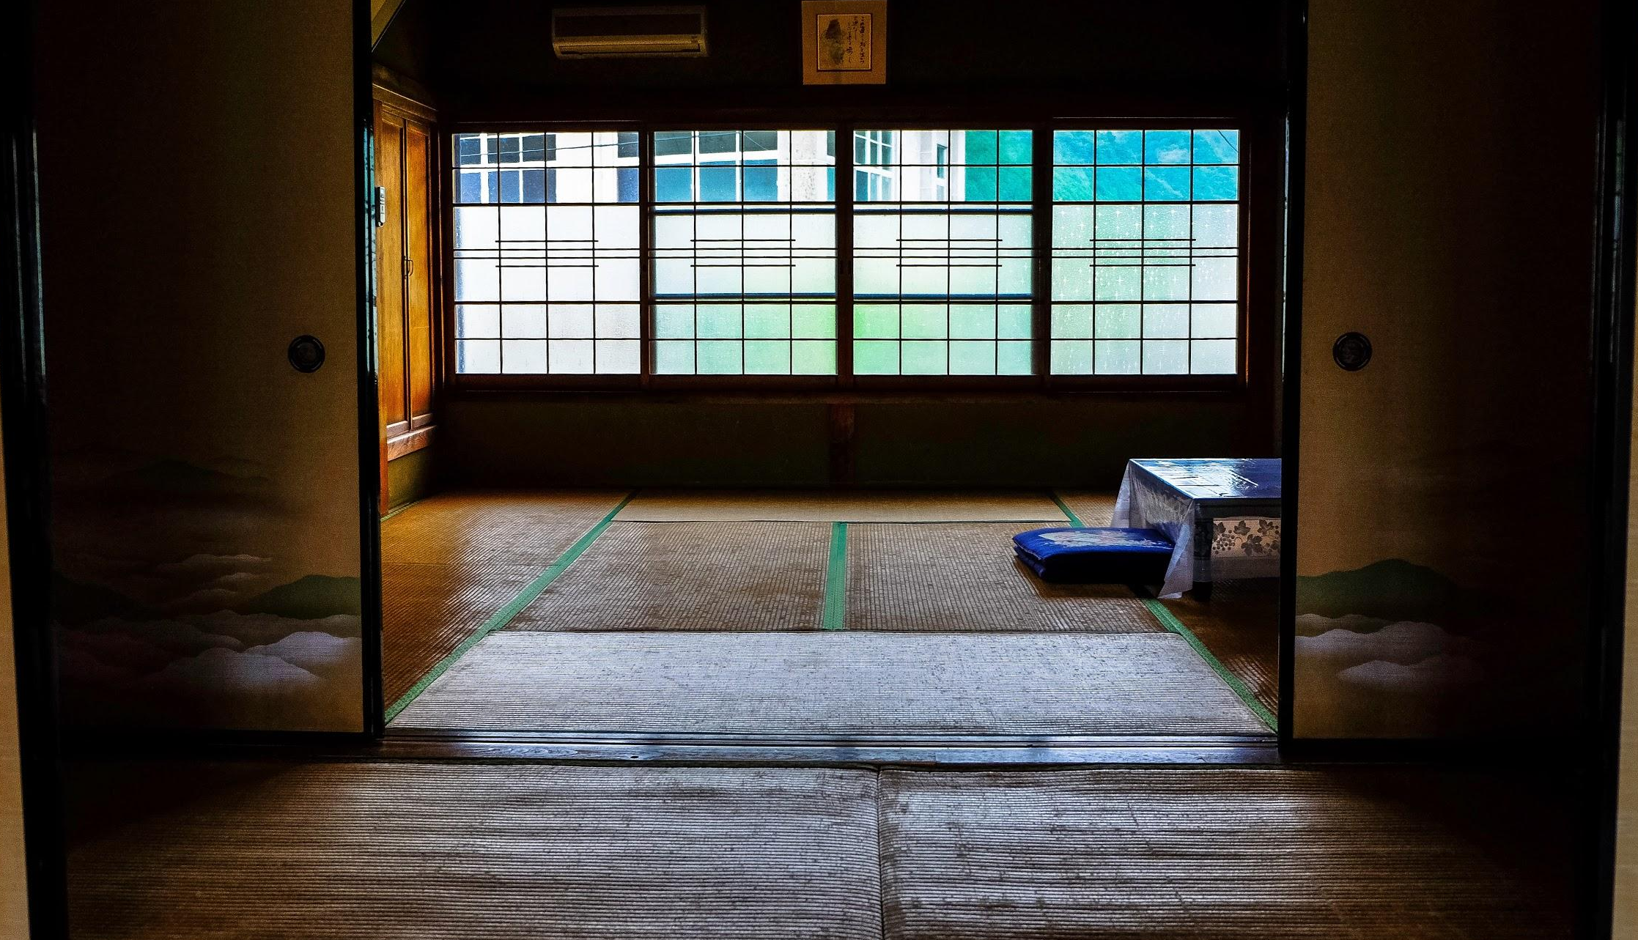


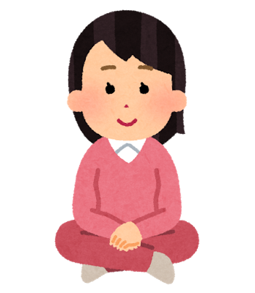
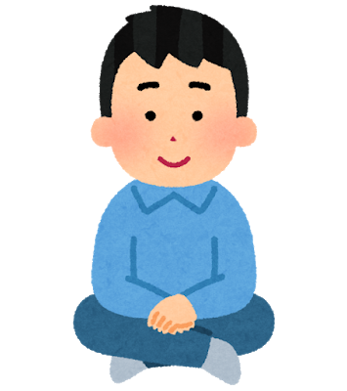


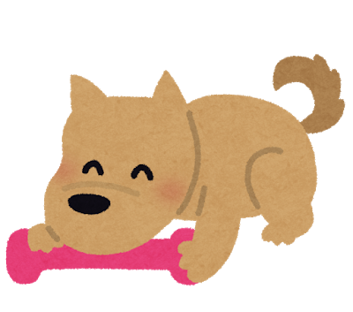
How many seasons are there?
Do you know the names of the seasons?
4
Notes:
Ask student what their favourite season is.

Slide 3
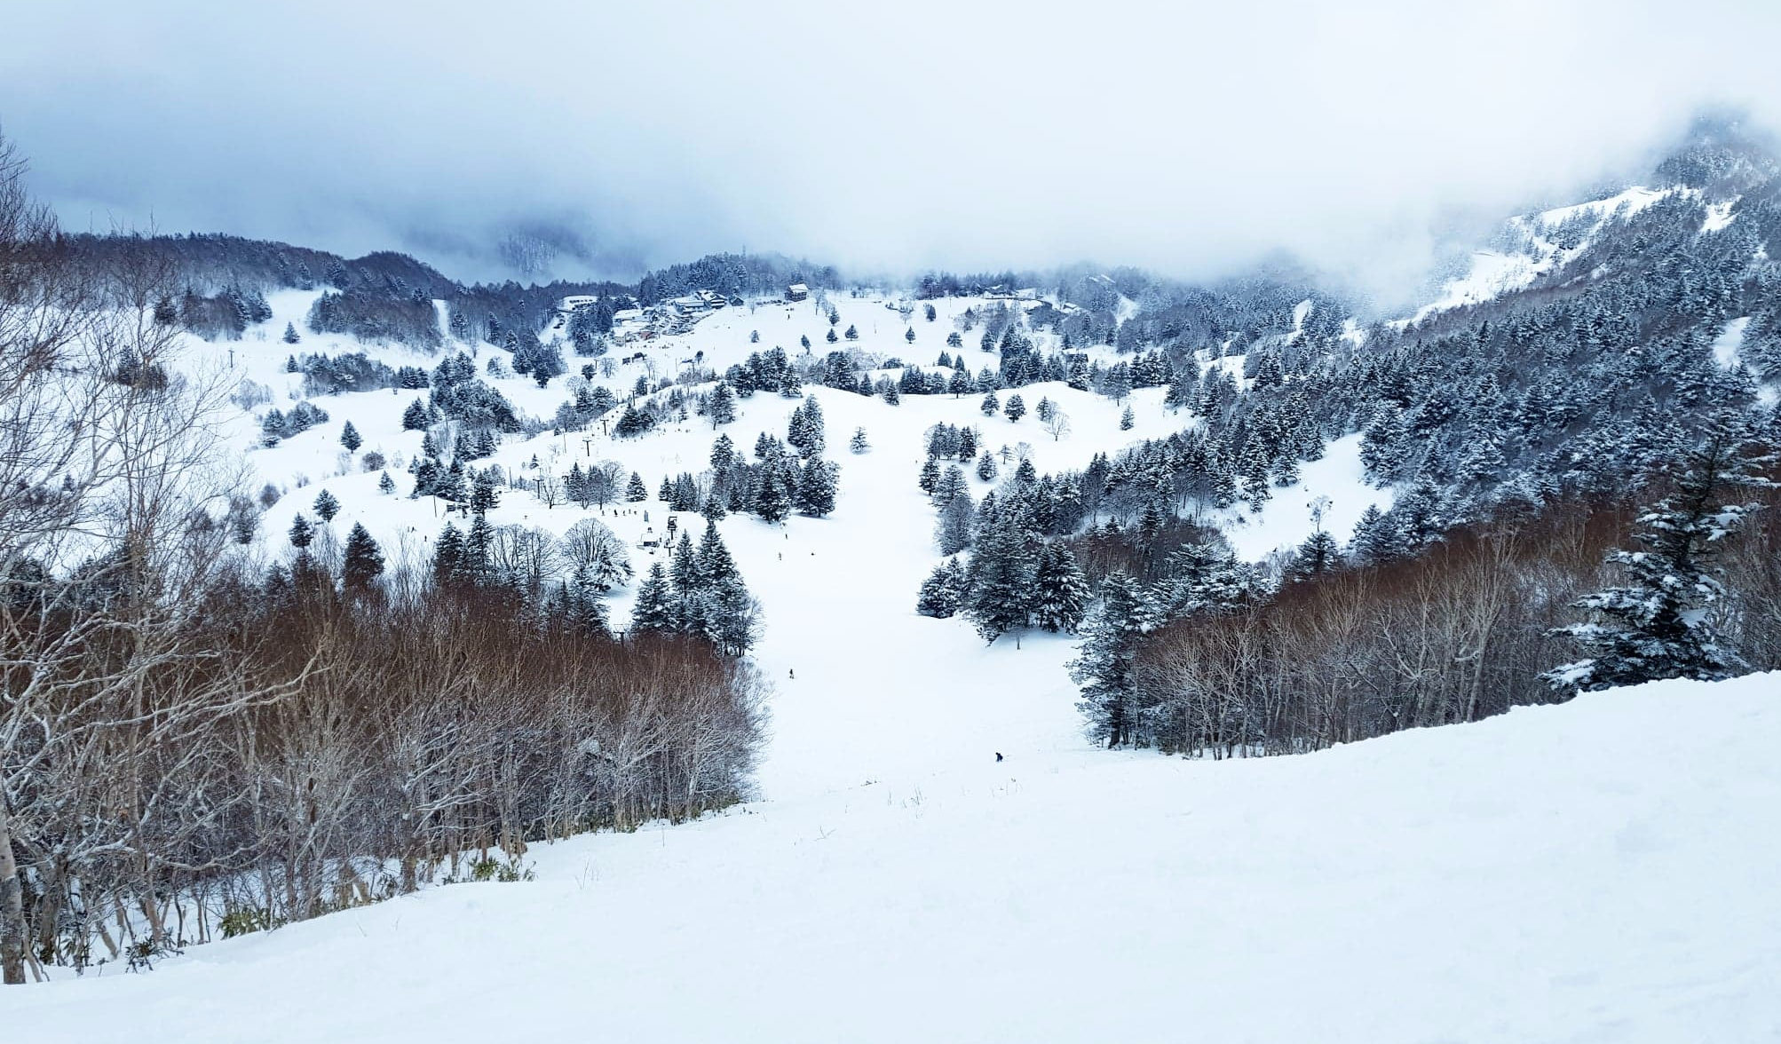

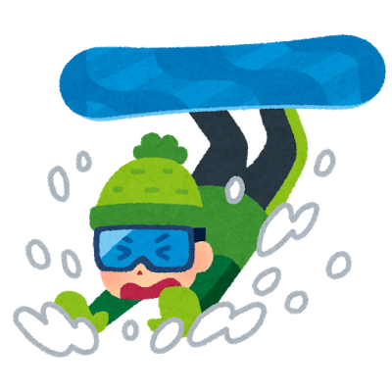
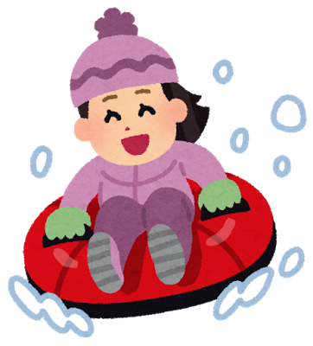
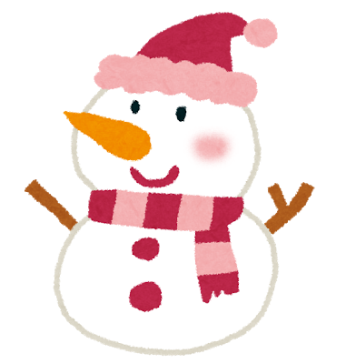
Winter can be very cold. It can sometimes snow.
What do you like in winter?
Haruto likes snowboarding. He does not like falling over!
Yui likes sledging!
Dog likes building snowmen! Do you like building snowmen?

Slide 4
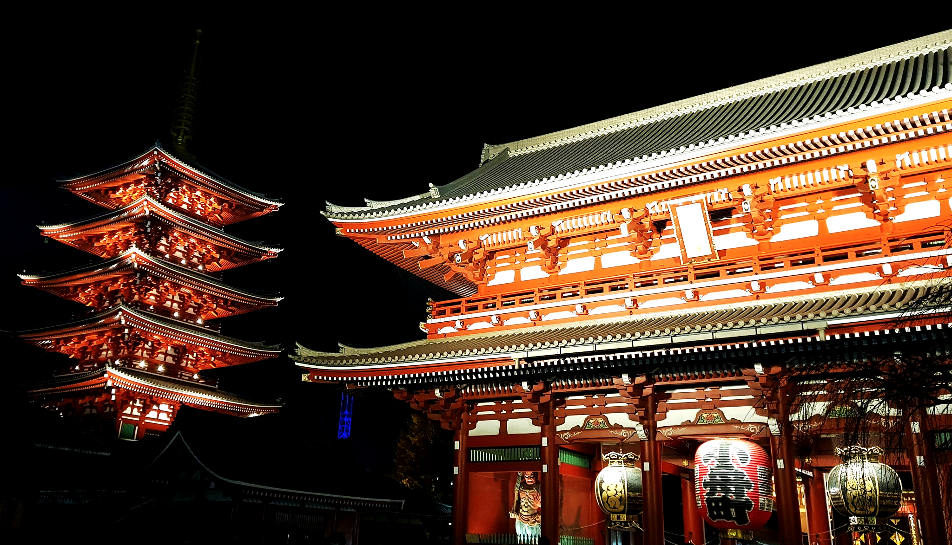
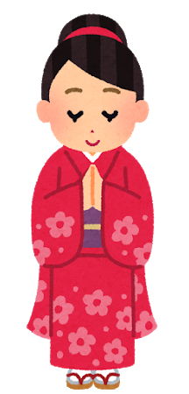
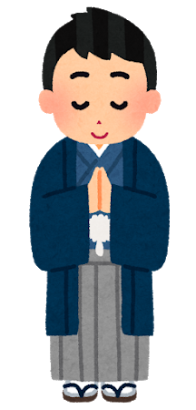
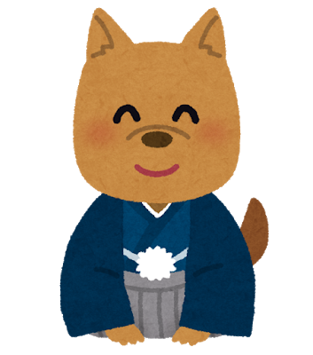
Dog, Yui and Haruto go to a shrine!
In winter we celebrate New Year.
Where do you go to celebrate?

Slide 5
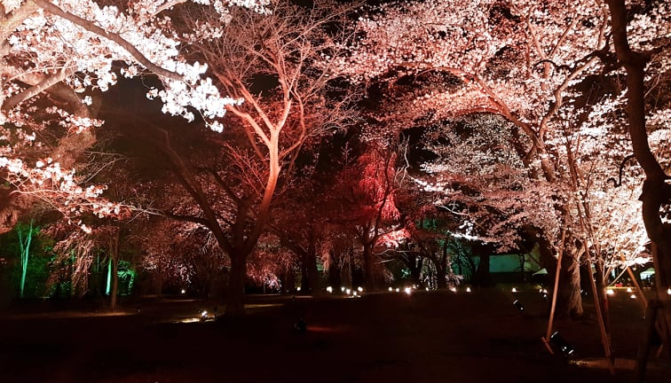
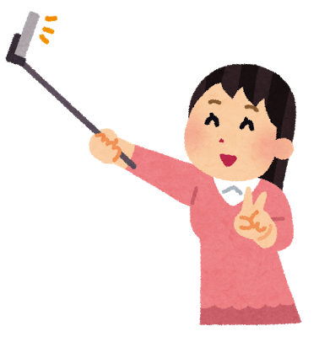
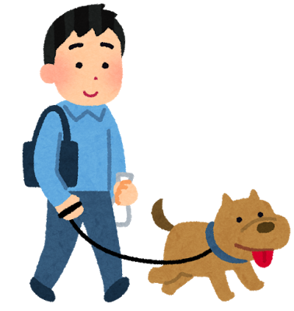
Dog likes walking. The cherry blossom is beautiful!
Yui likes taking pictures of the cherry blossom.
What do you like in spring?
Notes:
Ask students what season comes next.

Slide 6
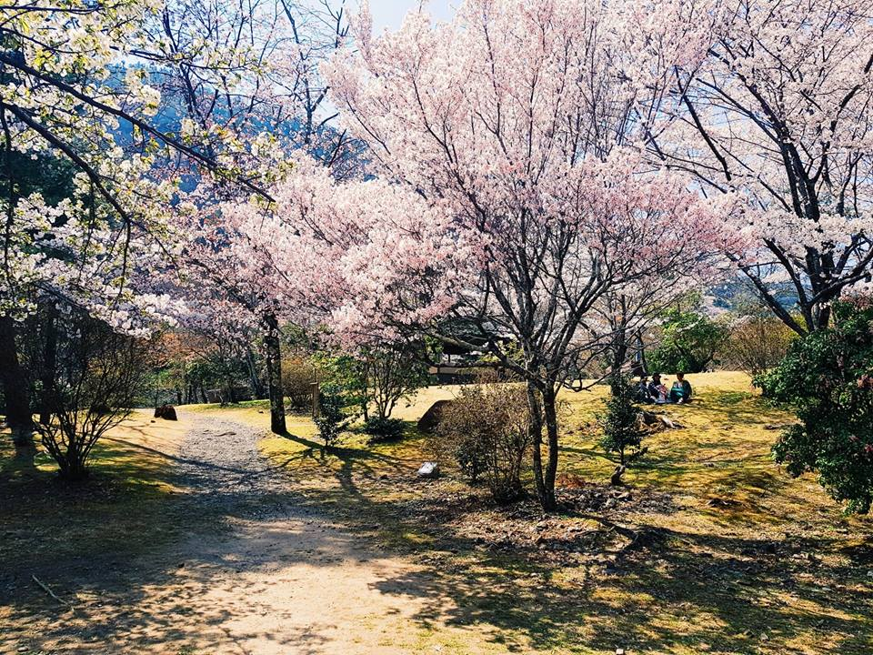
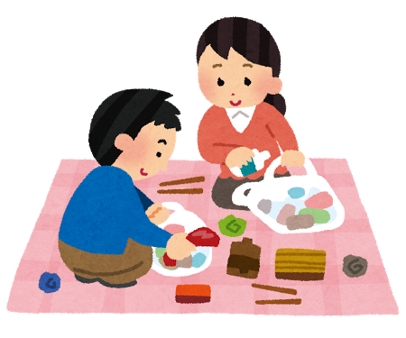
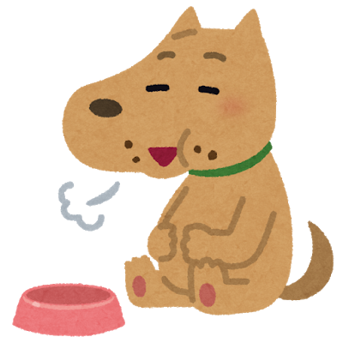
What do you like eating during Hanami?
Yui and Haruto like eating delicious bento.
Dog likes eating food!

Slide 7
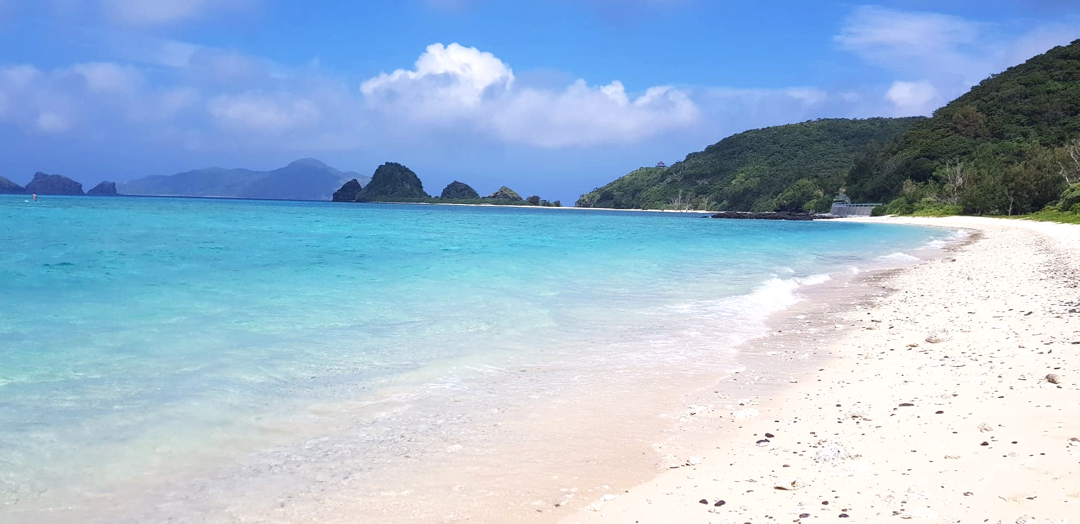


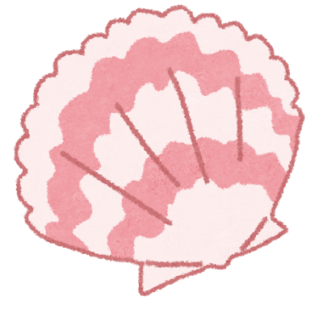

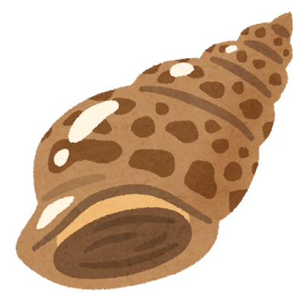
Dog, Haruto and Yui are in Okinawa!
Yui likes water sports!
Dog likes finding shells.
Where do you like to go in summer?
Haruto likes reading books.

Slide 8

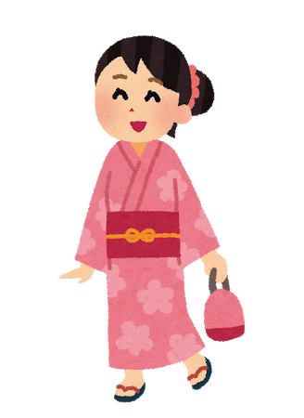
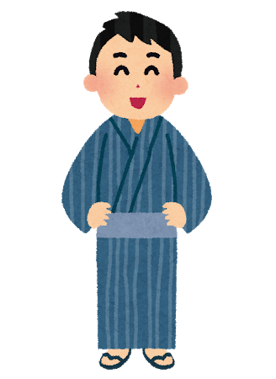
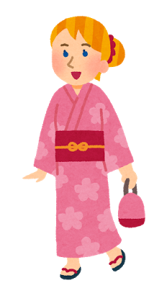
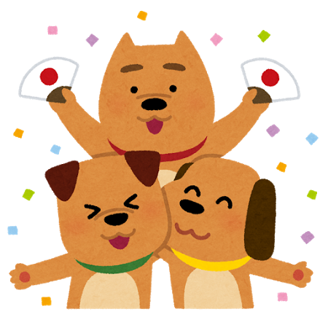
In summer there are festivals. Who do you go with?
Yui and Haruto go with their friend Sarah.
Dog has friends too!

Slide 9
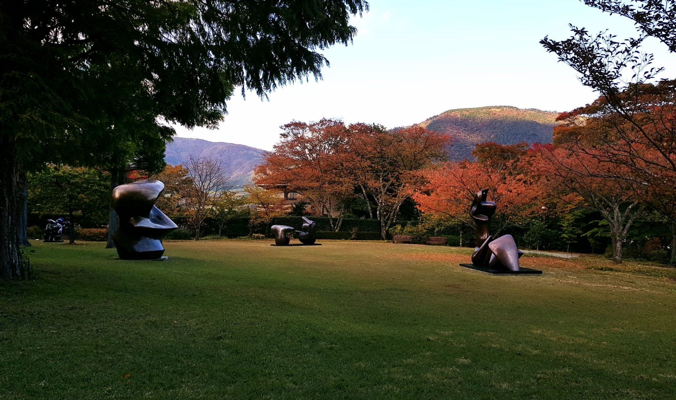
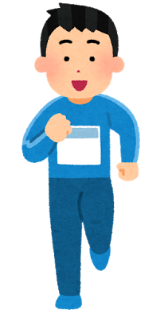
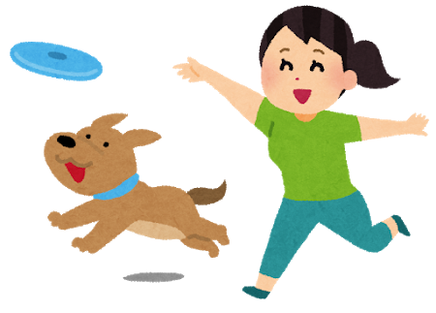
Yui and Dog like playing fetch!
In Autumn the leaves turn red. What do you like in Autumn?
Haruto likes running.

Slide 10

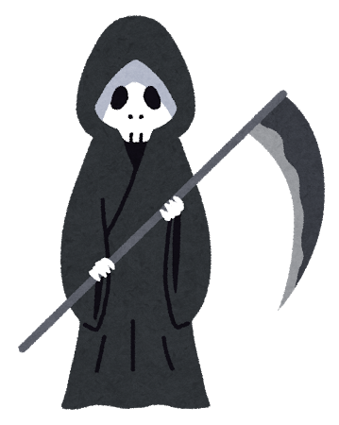
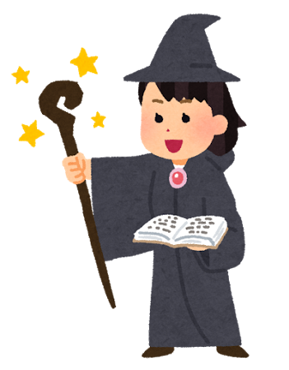

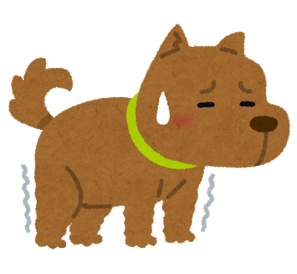
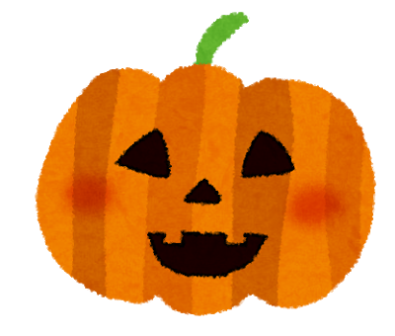
Haruto is the Grim Reaper.
Yui is a witch!
What holiday is this?
Halloween!
It is Halloween!
Dog is very scared! He doesn’t like Halloween

Slide 11
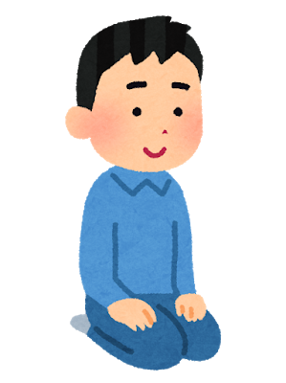
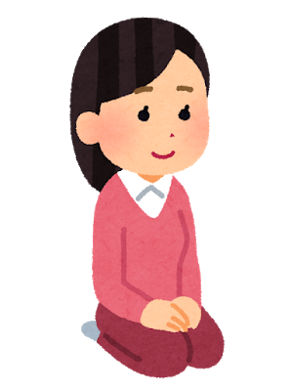
Dog doesn’t care what season it is...
He just likes his friends!

Slide 12
Let’s name the seasons!
Notes:
The order the words will appear in is, Winter, Spring, Summer and Fall

