Slide 1

Let’s Cook in English!

Slide 2

What food do you like?
Notes:
Teacher: What food do you like?
Who likes curry? Raise your Hand

Slide 3
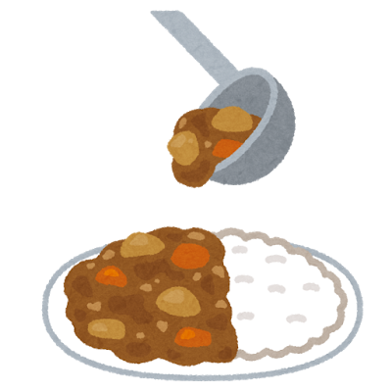

Let’s make curry!
Notes:
T: Today, let’s make curry!

Slide 4
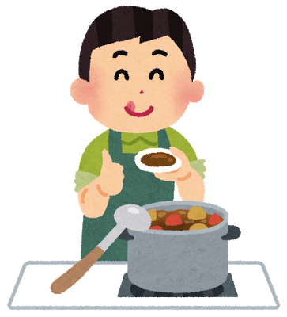
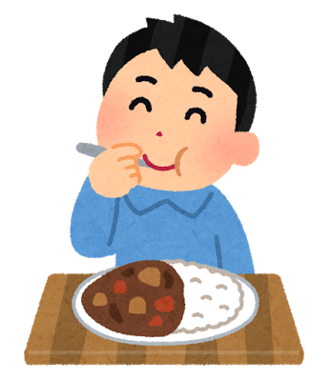
How do we make curry?
Notes:
Who likes curry?
T: What ingredients do we need to make curry? What ingredients does curry have?
How do we make curry?

Slide 5





What are the ingredients?
Onion
Rice
Potato
Roux
Carrot
Notes:
Roux pronunciation ルー
Teacher: What are the ingredients of curry?
Repeat each word x2

Slide 6

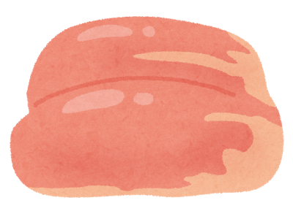
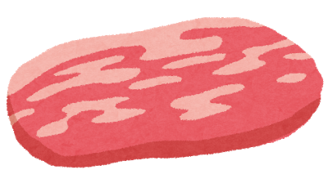
Meat
Beef
Chicken
Pork
Notes:
T: Which meat should we choose?
Which one do you like?
Which one?
Who likes beef? Raise your hand

Slide 7





What else do we need?
Knife
Pot
Rice Cooker
Cutting Board
Notes:
Repeat each word x2

Slide 8

First, cook the rice.
Notes:
First, let’s cook the rice!
We need rice to eat with our curry.

Slide 9

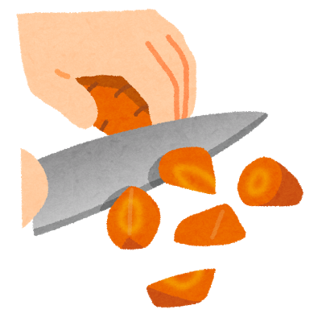

Second, wash and cut the vegetables.

Slide 10



Slide 11

Third, stir fry/ sauté the meat and vegetables.
Notes:
Stir fry the meat and vegetables. Stir fry/ Sauté. Third, sauté the meat and vegetables.

Slide 12
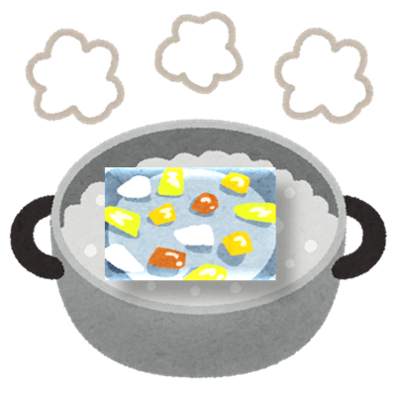


Next, add water and boil.

Slide 13

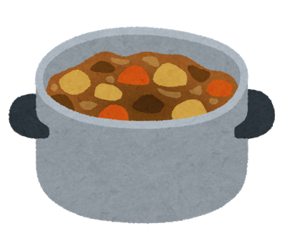
Put the roux in the pot.
Notes:
Put in the roux.

Slide 14
Stir!
Notes:
Stir the pot! Mix!

Slide 15
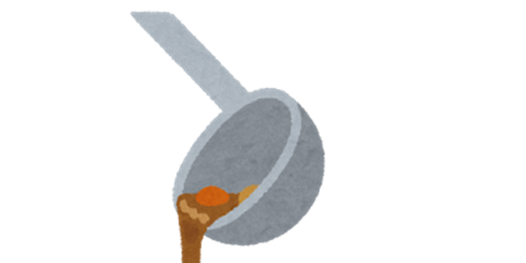
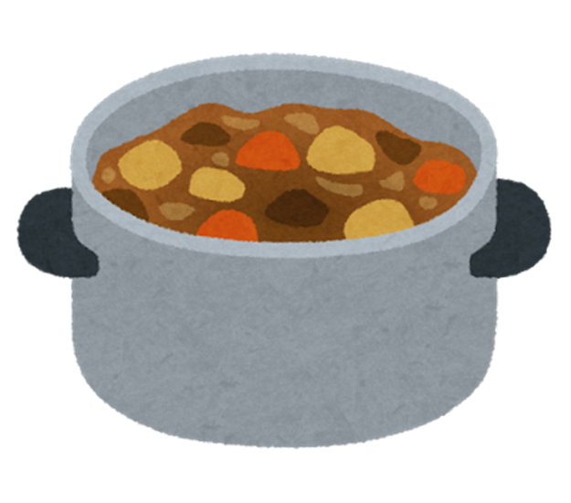
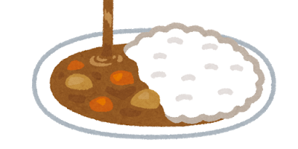
Serve the rice and curry on a plate.
Notes:
Put the rice and curry on a plate.

Slide 16
Let’s eat!!

Slide 17
Let’s Cook in English!
Written by Juliana Boucree
（神奈川県立総合教育センター February 2018）
イラスト：いらすとや

