Slide 1
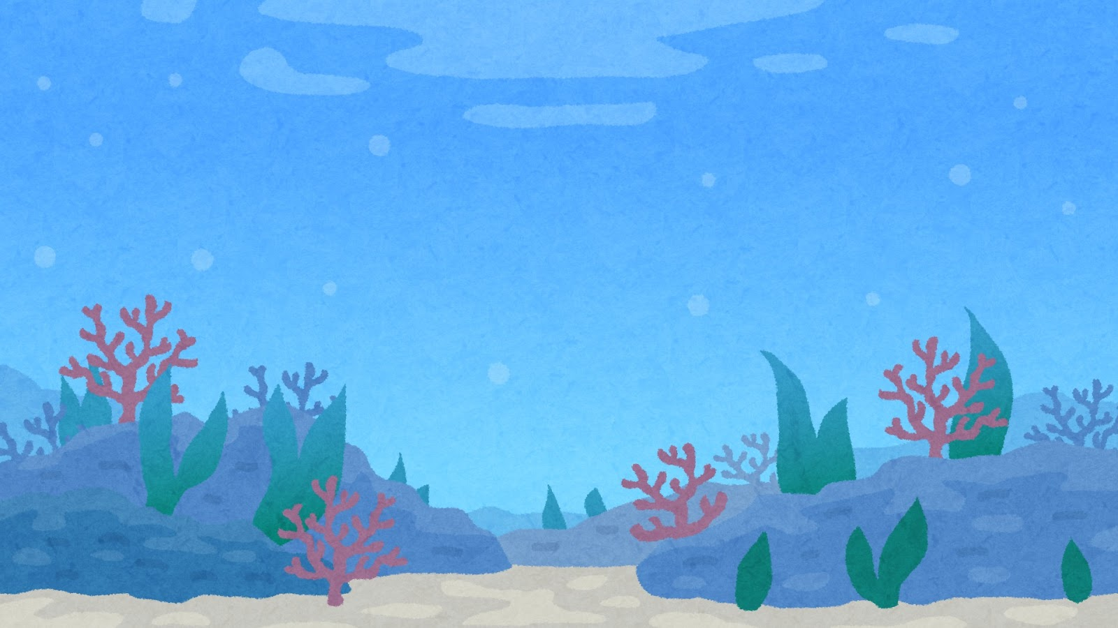
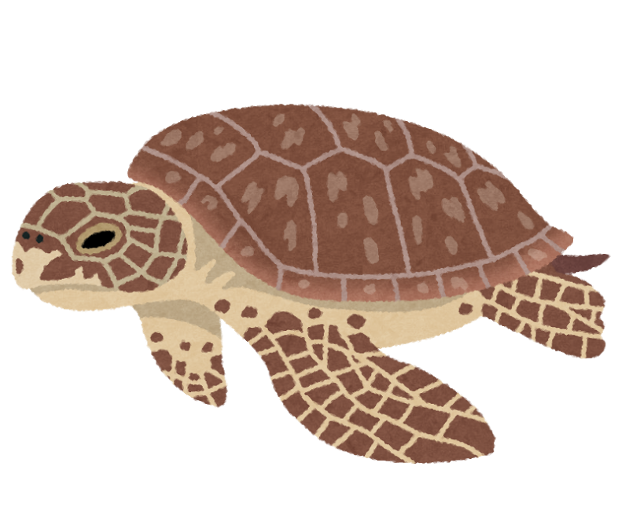
Notes:
（JTE：児童とのやり取り） （注）JTE=Japanese Teacher of English（日本人の英語の先生）
What’s this?
★×３（アニメ：少しずつ登場）
YES.
★
This is turtle.
★

Slide 2
Turtle Likes to Swim
Notes:
（JTE）
Today.
I’ll read to you,
“Turtle Likes to Swim”.
★

Slide 3
This is Turtle.
Notes:
（ALT） （注）ALT=Assistant Language Teacher（外国語指導助手）
This is Turtle.
★

Slide 4
Turtle likes to swim.
Notes:
（ALT）
Turtle likes to swim.
（アニメ：泳ぐ）
（ジェスチャー）
★

Slide 5
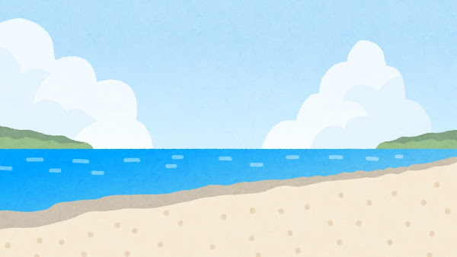

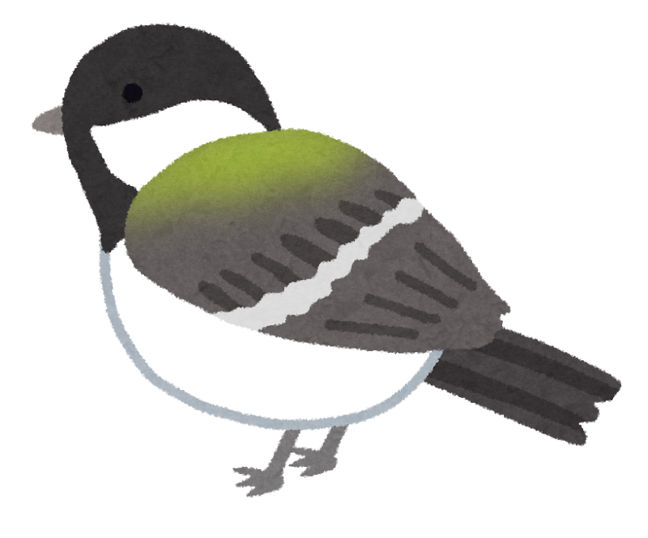
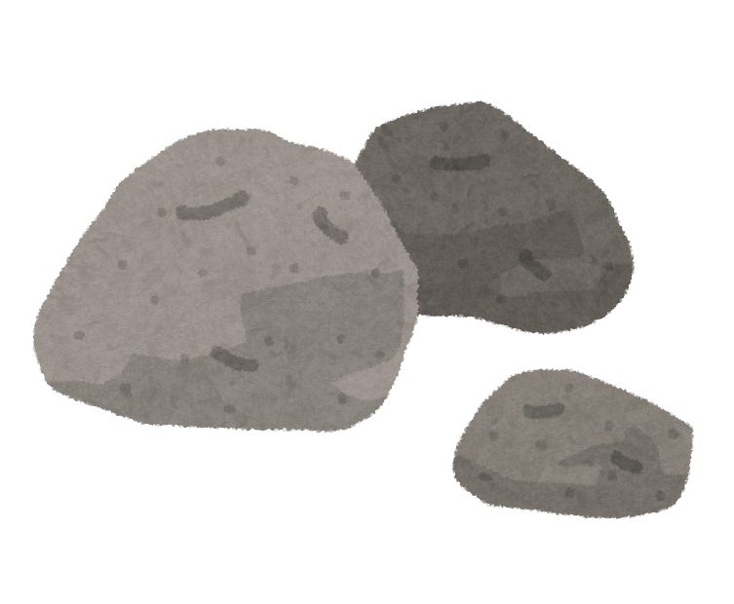

Turtle saw Bird.
Notes:
（ALT）
（アニメ：近づく）
Turtle saw Bird.
★

Slide 6
Turtle asked Bird, “Do you like to swim?”
Notes:
（ALT）
Turtle asked Bird,
“Do you like to swim?”
★

Slide 7



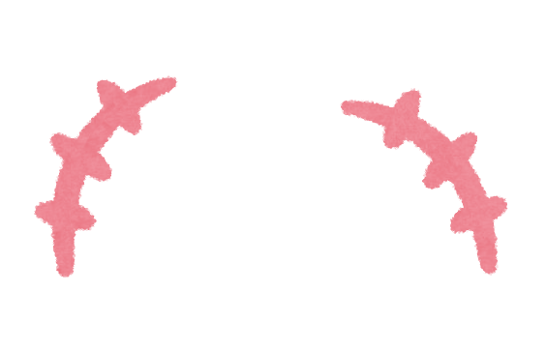
Bird said, “No, I like to sing.”
Notes:
（JTE）
Bird said,
“No, I like to ・・・
★（アニメ：歌う）
sing.”
★

Slide 8
“Oh no…”
Notes:
（ALT）
“Oh no…”
（アニメ：消える）
★

Slide 9
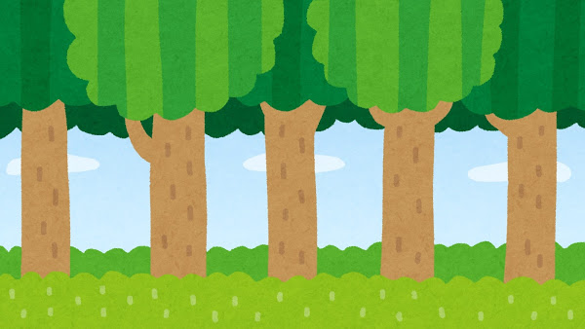
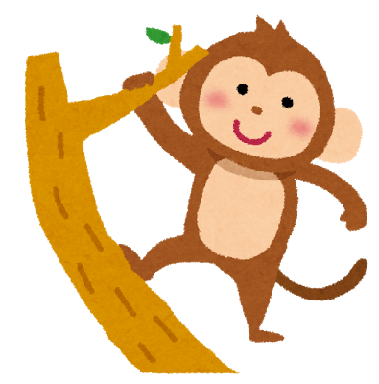
Turtle saw Monkey.
Notes:
（ALT）
（アニメ：近づく）
Turtle saw Monkey.
★

Slide 10
Turtle asked Monkey, “Do you like to swim?”
Notes:
（ALT）
Turtle asked Monkey,
“Do you like to swim?”
★

Slide 11
Monkey said, “No, I like to swing.”
Notes:
(JTE）
Monkey said,
“No, I like to ・・・
★（アニメ：揺れる）
swing.”
（ジェスチャー）
★

Slide 12
“Oh no…”
Notes:
(ALT)
“Oh no…”
（アニメ：消える）
★

Slide 13
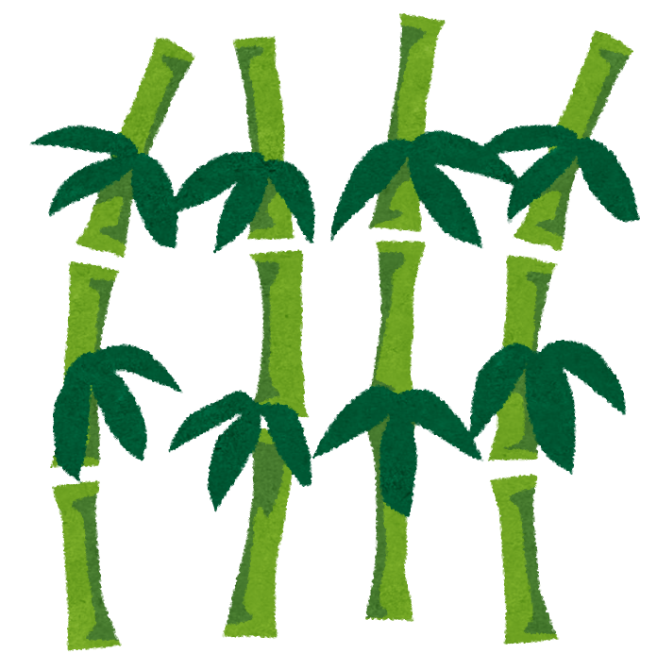
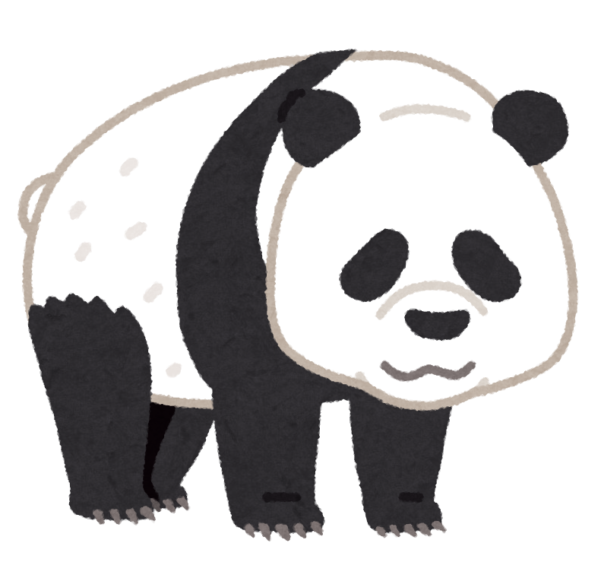
Turtle saw Panda.
Notes:
（ALT）
What’s this ?
★
Yes.
This is Panda.
Turtle saw Panda.
★

Slide 14
Turtle asked Panda, “Do you like to swim?”
Notes:
（ALT）
Turtle asked Panda,
“Do you like to swim?”
★

Slide 15
Panda said, “No, I like to eat.”
Notes:
(JTE）
Panda said,
“No, I like to ・・・
★（アニメ：食べる）
eat.”
（ジェスチャー）
★

Slide 16
“Oh no…”
Notes:
(ALT)
“Oh no…”
（アニメ：消える）
★

Slide 17
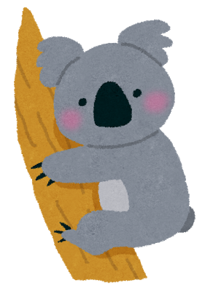
Turtle saw Koala.
Notes:
(ALT)
（アニメ：近づく）
Turtle saw Koala.
★

Slide 18
Turtle asked Koala, “Do you like to swim?”
Notes:
(ALT)
Turtle asked Koala,
“Do you like to swim?”
★

Slide 19
Koala said, “No, I like to sleep.”
ＺＺＺＺ・・
Notes:
(JTE）
Koala said,
“No, I like to
★（アニメ：寝る）
・・・ sleep.”
（ジェスチャー）
★

Slide 20
“Oh no…”
ＺＺＺＺ・・
Notes:
(ALT)
“Oh no…”
（アニメ：消える）
★

Slide 21
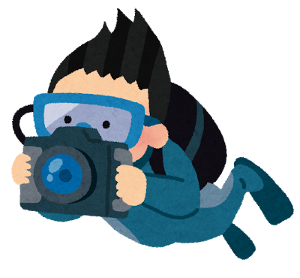
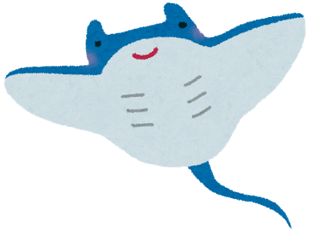
Turtle saw Manta Ray.
Notes:
(ALT)
Turtle saw Manta Ray.
★

Slide 22
Turtle asked Manta Ray, “Do you like to swim?”
Notes:
(ALT)
Turtle asked Manta Ray,
“Do you like to swim?”
★

Slide 23
Manta Ray said, “Yes, I like to swim!”
Notes:
(JTE）
Manta Ray said,
“Yes, I like to ・・・
★（アニメ：泳ぐ）
swim!”
（ジェスチャー）
★

Slide 24
“Yay! I’m so happy!”
Notes:
(ALT＆JTE)
“Yay! I’m so happy!”
（アニメ：喜ぶ）
★

Slide 25
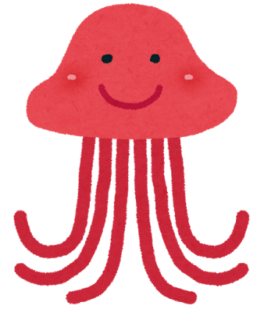
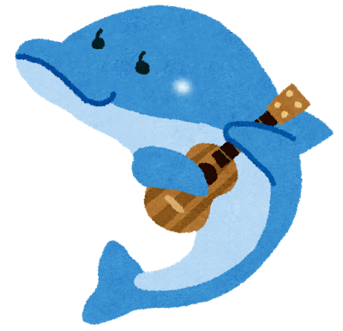
Turtle and Manta Ray swam together happily.
Notes:
(ALT)
Turtle and Manta Ray swam together happily.
★

Slide 26
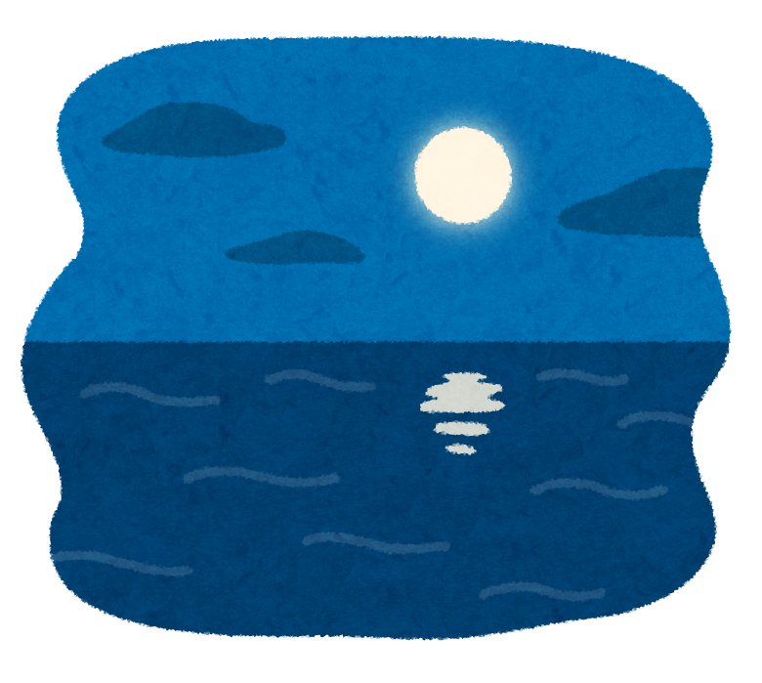
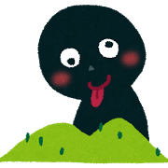
THE END!
Written by Juliana Boucree and Sophia Chow
（神奈川県立総合教育センター July 2017）
イラスト：いらすとや
Notes:
（ALT）
The End.
Do you like to swim?
Yes → “Yay! I’m so happy!”
No → “Oh no…”

